Slide 1
RAIL: Resilient Analog Instance Language/Library

Slide 2
Contents
0. RAIL-Lib
1. Design Procedure
2. ADC Architecture
3. Sub-Circuit Design
4. ADC Core Layout
5. Full-Chip ADC Layout

Slide 3
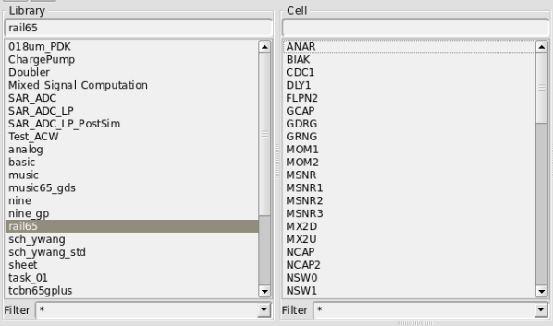
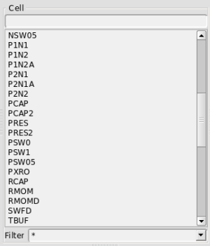
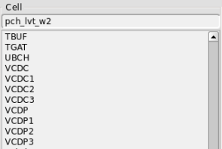
0. RAIL-Lib
RAIL-Lib is a process-portable standard cell library for mixed signal circuit agile design.
It contains 29 types of 51 standard cells.
1

Slide 4
0. RAIL-Lib
Why RAIL-lib?
Short design cycle
You can design and simulation a ADC from schematic to full-chip GDS in 2 weeks.
Open source
You can add and amend standard cells according to your need.
Flexibility
Using RAIL-Lib, you can build operational amplifier, biasing circuit, bootstrap switch, comparator, capacitive DAC array and many other circuits can be used in mixed signal circuits.
No need for custom layout design
You can generate layout using existing TCL scripts by run them in ICC, just need to adjust parameter or exchange standard cell. You can also add and amend these scripts.
Easy to amend your design
You can exchange standard cell in your circuit, without adjustment of W/L of MOSFETs. You can amend your layout by just change TCL script, no need to adjust layout of the whole chip.
2

Slide 5
1. Design Procedure
Verilog, VDHL or digital standard cell.
Digital logic design & simulation
Simulation of the whole ADC, pre-layout of digital and post-layout of analog.
Pre-layout simulation of the whole ADC.
Post-layout simulation of the whole ADC.
ADC architecture
ADC simulation
ADC simulation
ADC layout & simulation
Full-chip simulation & layout
Analog circuit design & simulation using RAIL-Lib
Analog circuit layout & simulation using RAIL-Lib
Full-chip GDS
Using RAIL-Lib build analog circuits, like bootstrapped switch, comparator et al. Pre-layout simulation.
Using RAIL-Lib build layout of analog circuits, and then post-layout simulation of these analog circuits
3

Slide 6
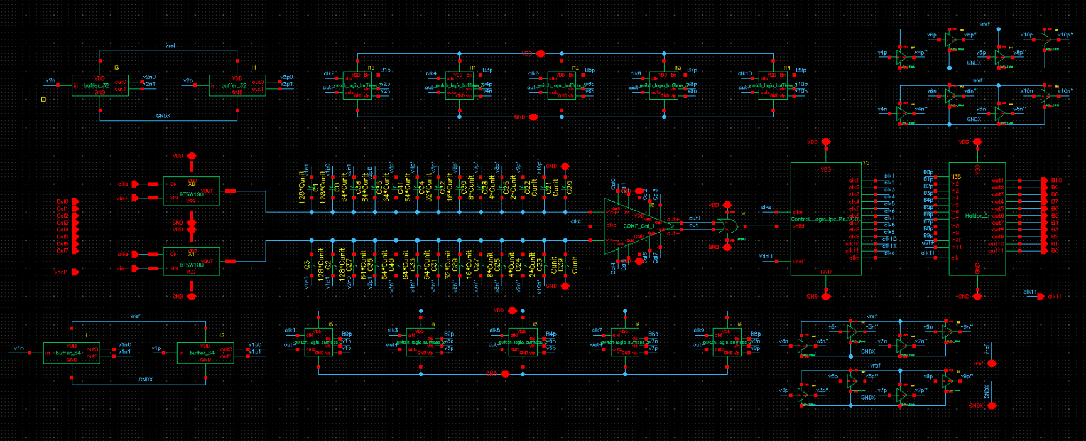
2. ADC Architecture
Fig. 1. Schematic of the SAR ADC
Switch
Comparator
CDAC
VCDL
This is a single channel single stage successive approximation (SAR) ADC. It requires two switches, one comparator, one capacitive DAC (CDAC) array, one voltage controlled delay line (VCDL) used in digital control logic and digital control logic. The switch, comparator, CDAC and VCDL can be designed using RAIL-Lib, which will be elaborated in detail in next chapter.
4

Slide 7
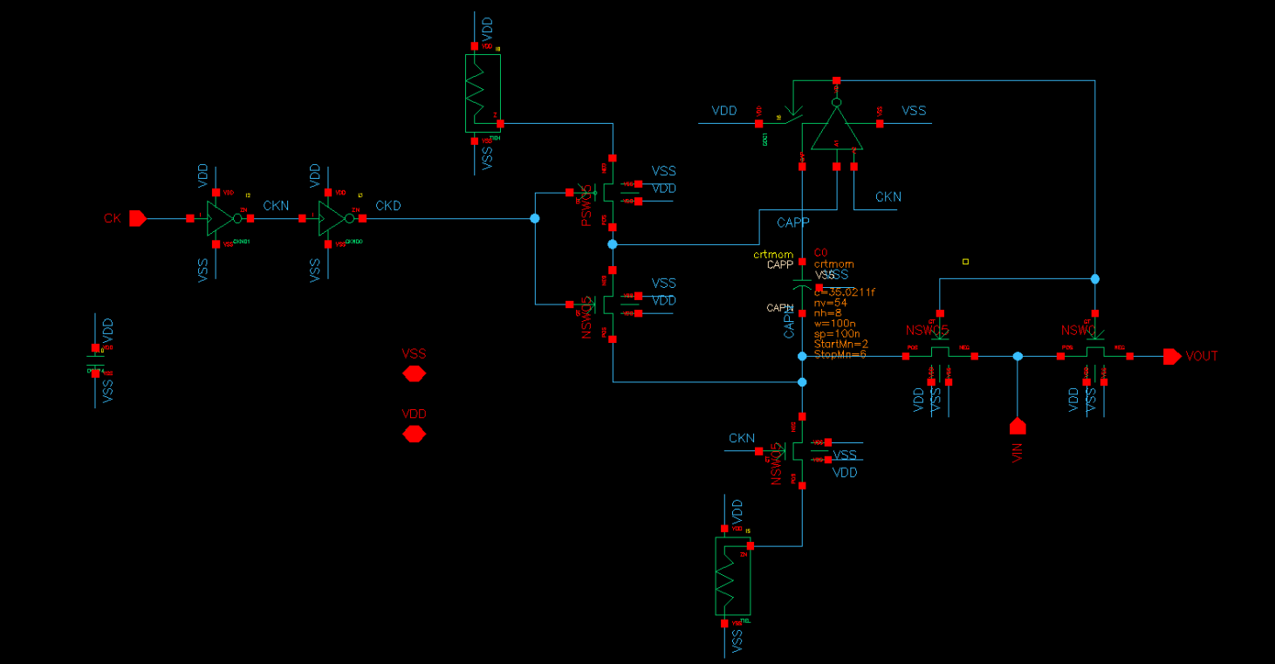
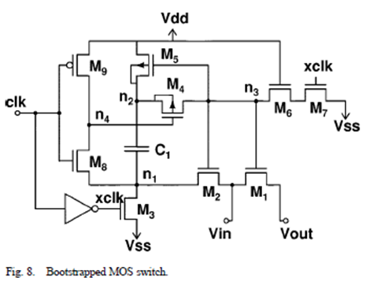
3. Sub-Circuit Design
Bootstrap Switch
Bootstrap switch consists of NSW、PSW、CDC、and CKND
Fig. 2. schematic of bootstrap switch
5

Slide 8
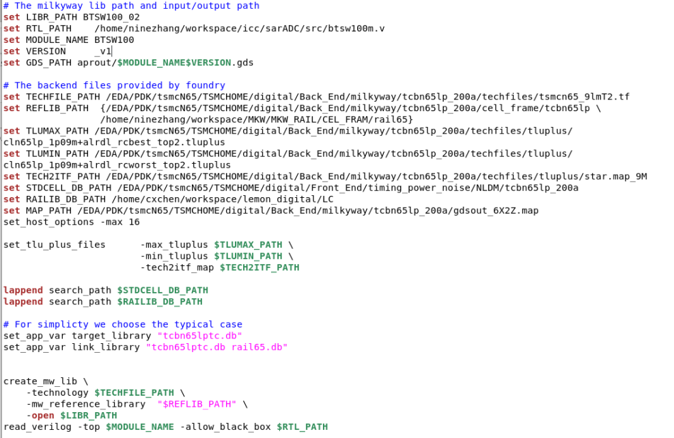
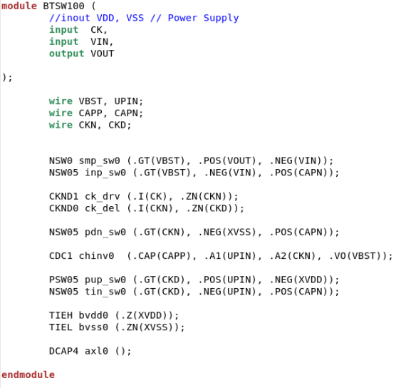
3. Sub-Circuit Design
Set working path
Configure library files path
Placement and routing
Create layout
Bootstrap Switch
Netlist : src/btsw100m.v
Script : script/btsw100.tcl
Fig. 3. netlist of bootstrap switch
Fig. 4. layout script of bootstrap switch
6

Slide 9
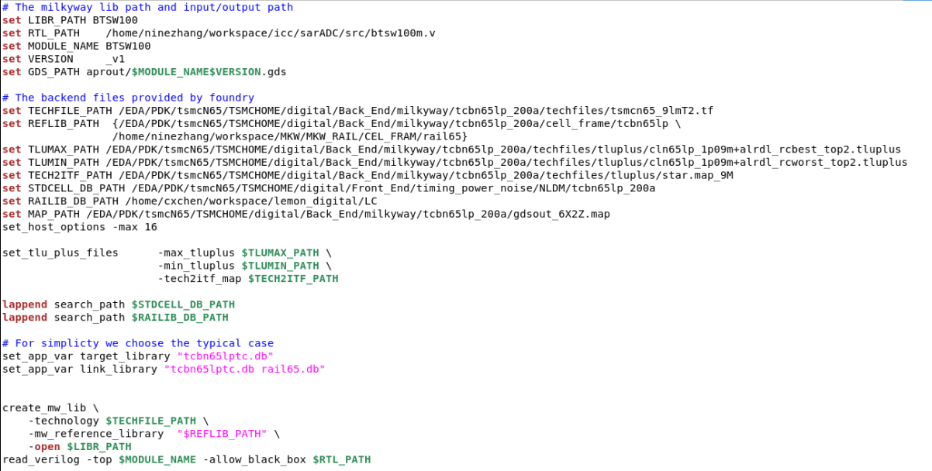
3. Sub-Circuit Design
MOM capacitor uses the parasitic capacitance of finger metal in the same layer. The layout script of crt_mom in schematic is as follows:
Bootstrap Switch
Fig. 5. layout script of crt_mom in schematic
7

Slide 10
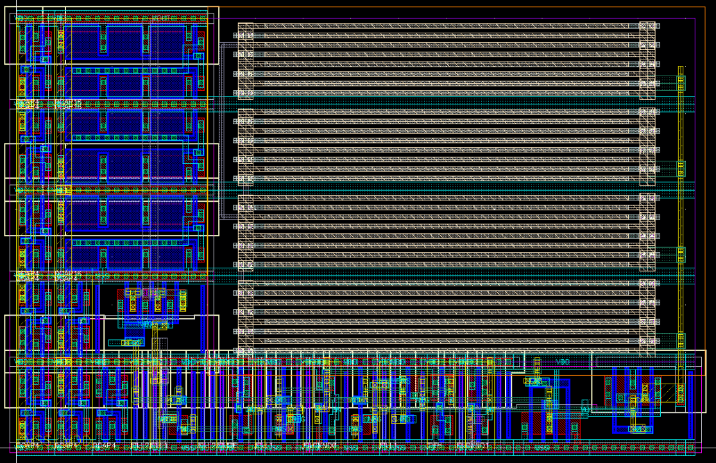
3. Sub-Circuit Design
Bootstrap Switch
Fig. 6. layout of bootstrap switch
8

Slide 11
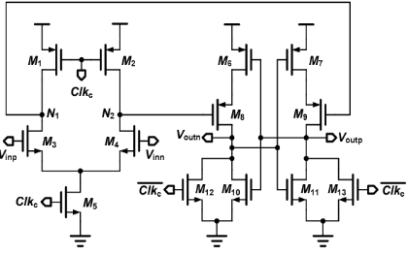
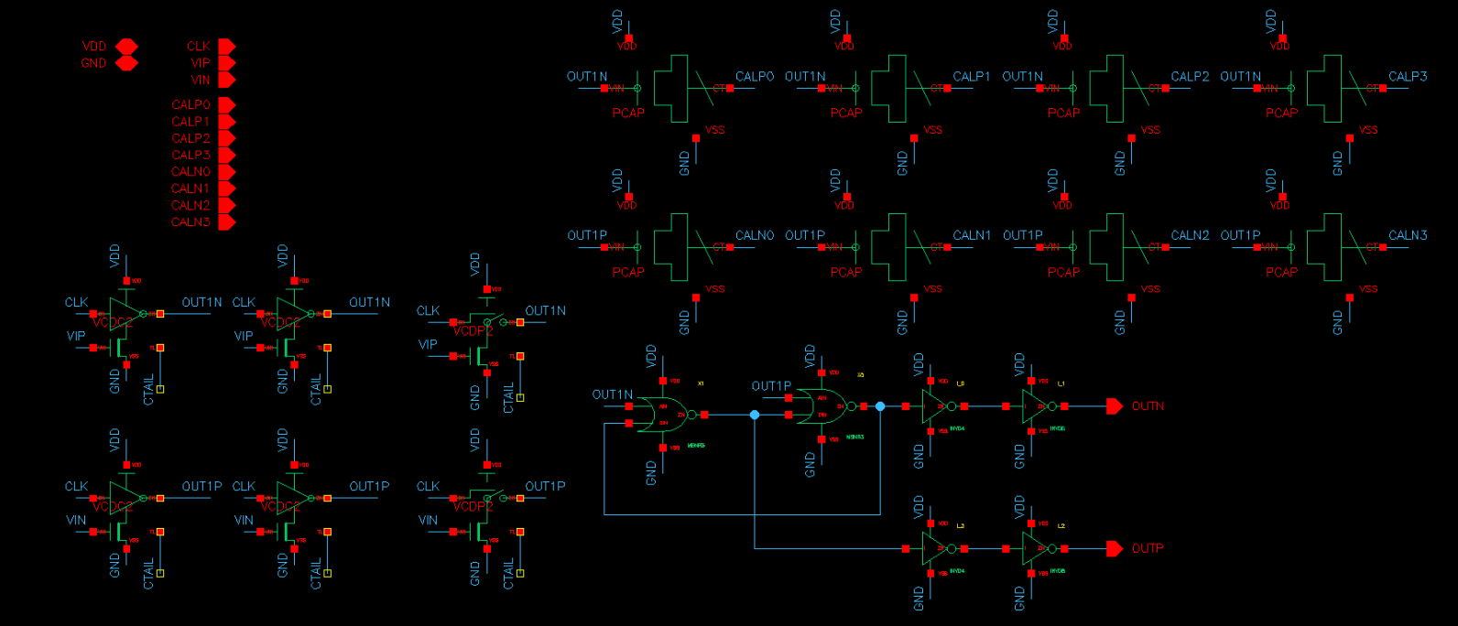
3. Sub-Circuit Design
Comparator
Comparator consists mainly of Dynamic Pre-amplifier and Latch.
Two VCDC2s in parallel and VCDP2s speeding up discharge compose the Dynamic Pre-Amplifier.
Two MSNR3 in back-to-back connection compose the Latch.
PCAPs therein are used to calibrate offset of comparator
Fig. 7. schematic of comparator
9

Slide 12
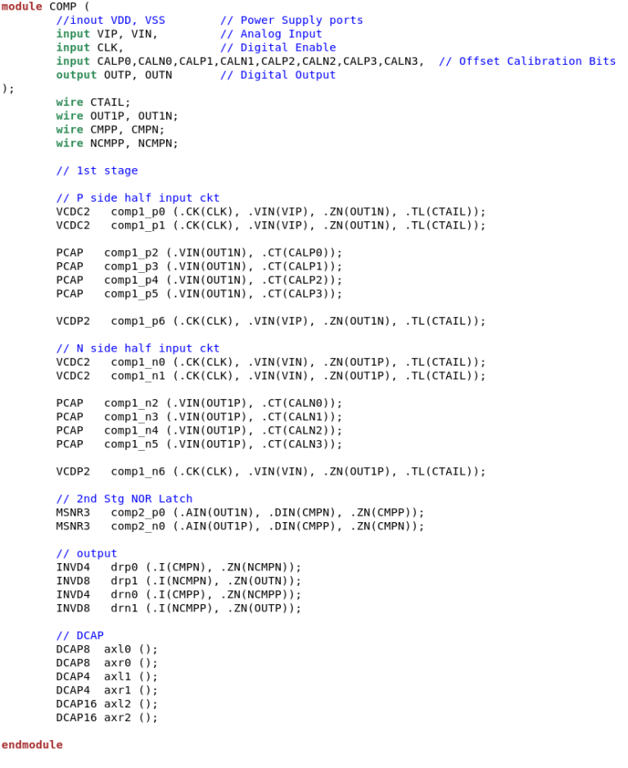
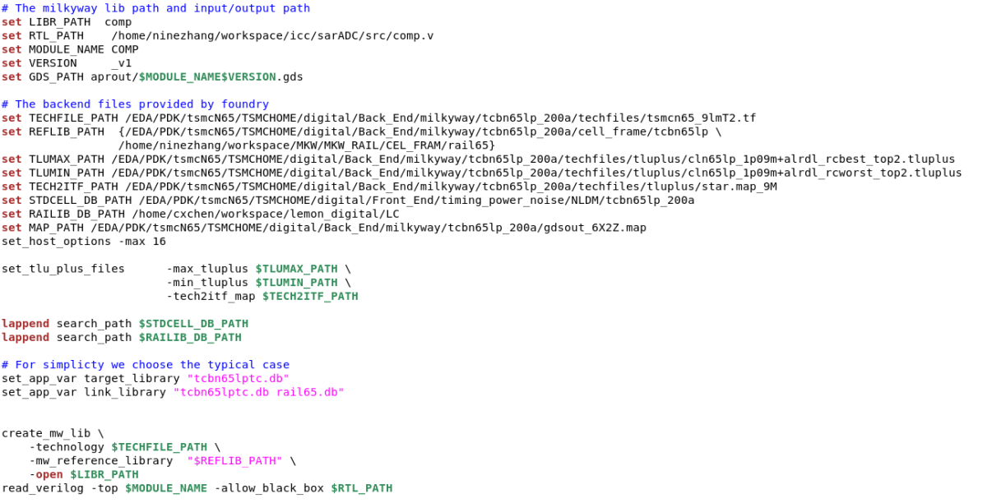
3. Sub-Circuit Design
Comparator
Netlist : src/comp.v
Script : script/comp.tcl
Fig. 9. layout script of comparator
Fig. 8. netlist of comparator
10

Slide 13
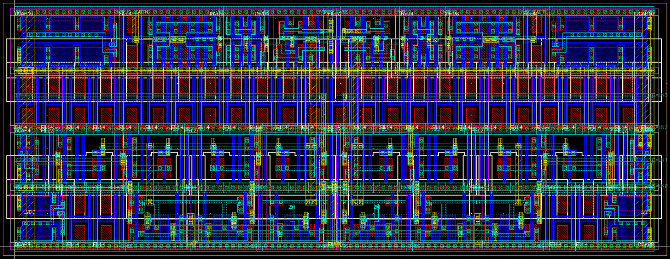
3. Sub-Circuit Design
Comparator
Fig. 10. layout of comparator
11

Slide 14
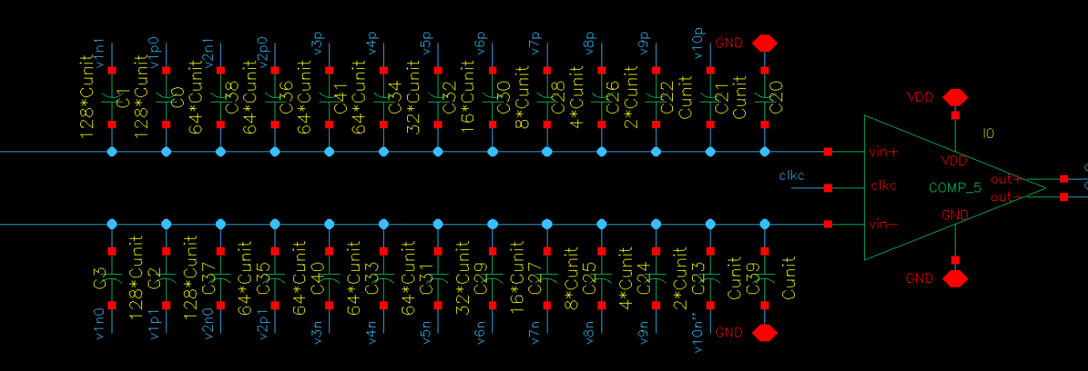
3. Sub-Circuit Design
CDAC Array
Using Binary Capacitor Array from C_{unit} to 256C_{unit} .
Value of redundant capacitor is 64C_{unit} .
Using split capacitor in the position of 128C_{unit} and 256C_{unit} .
MOM1 is used as unit capacitor.
Fig. 11. schematic of capacitor array
12

Slide 15
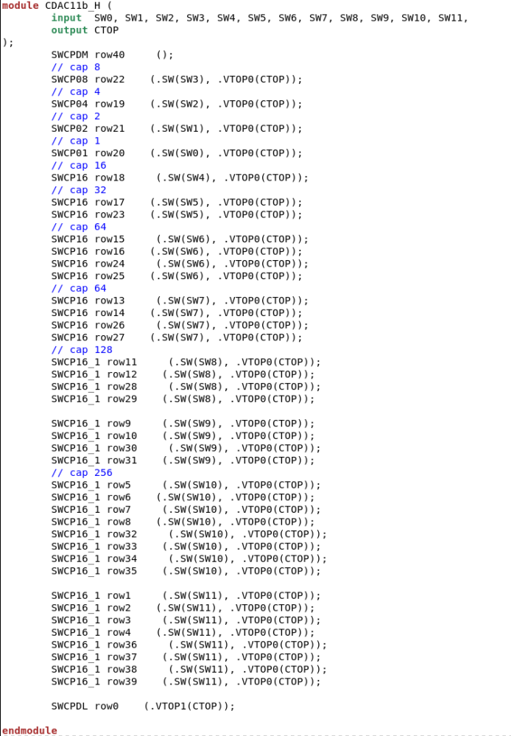
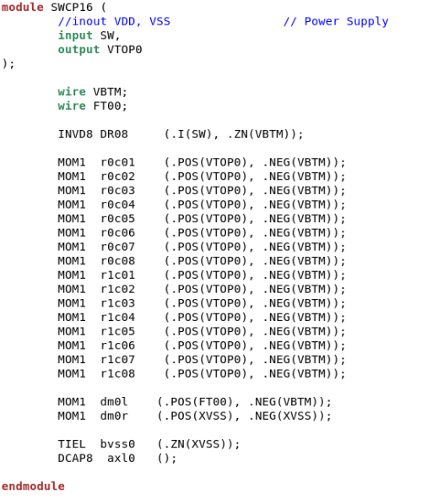
3. Sub-Circuit Design
CDAC Array
Netlist : src/cdac11b_h.v
Fig. 12. netlist of capacitor array
13

Slide 16
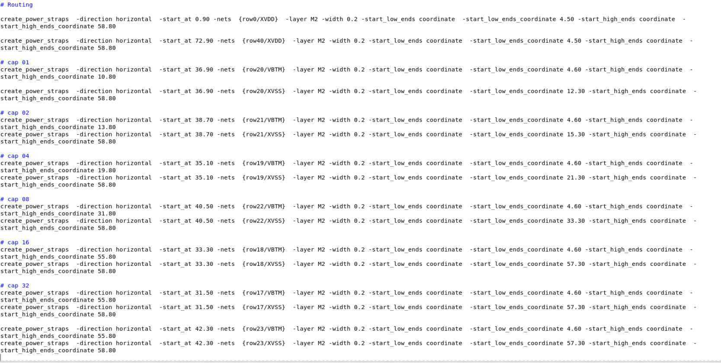
3. Sub-Circuit Design
CDAC Array
Script: script/cadc11b_h.tcl
Fig. 13. layout script of capacitor array
14

Slide 17

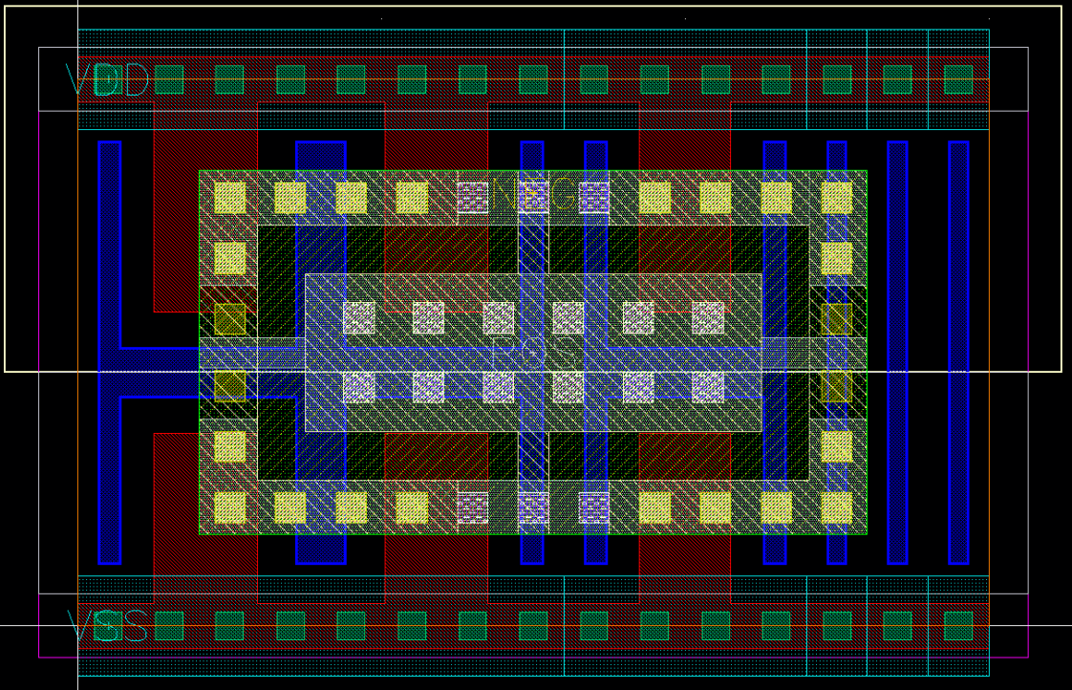
3. Sub-Circuit Design
CDAC Array
Fig. 14. layout of MOM1 cell
Fig. 15. layout of capacitor array
15

Slide 18
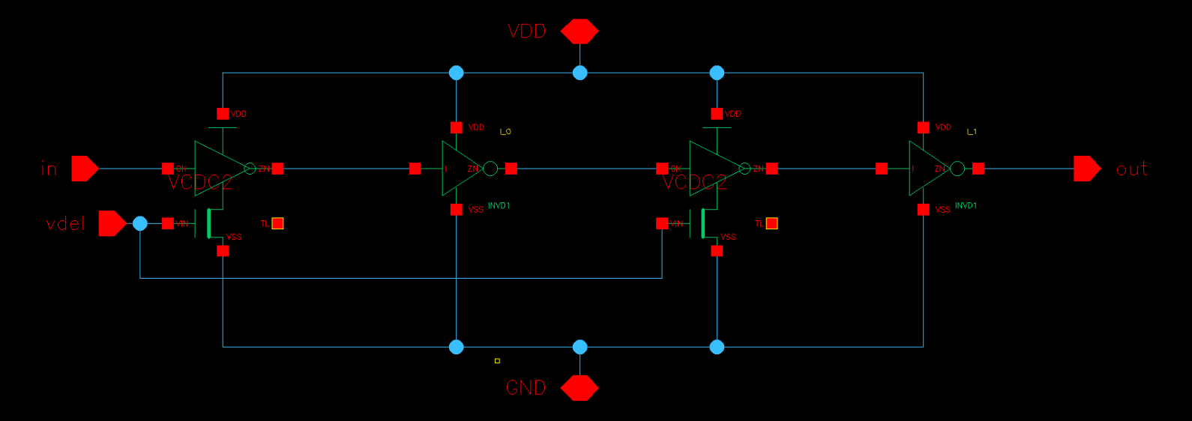
3. Sub-Circuit Design
VCDL
Using VCDC2 and INVD1 chain structure to construct voltage control delay line (VCDL) . Delay decreases with the increasement of control voltage. Schematic is as follows and layout is generate by ICC through automatic placement and routing in digital logic part.
Fig. 16. schematic of VCDL
16

Slide 19
4. ADC Core Layout
ADC core simulation for function verification: replacing switches, comparator, CDAC and VCDL by their corresponding PEX files.
Generate netlist of ADC schematic.
Call the ADC netlist and library files in script.
Create floorplan in ICC.
Placement and routing.
Checking LVS and DRC.
Parasitic parameter extraction.
Post-layout simulation of ADC core.
The whole layout can be generated by TCL script.
18

Slide 20
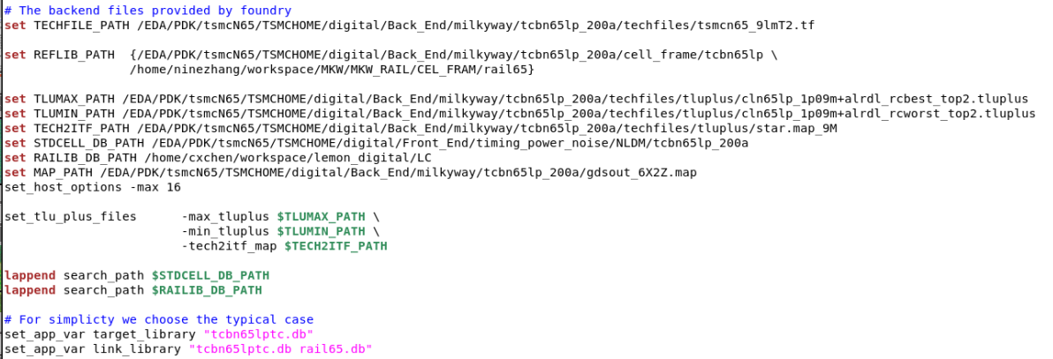

4. ADC Core Layout
Fig. 17. Setting library files and configuration files for ADC core
Fig. 18. Calling ADC core netlist
18

Slide 21
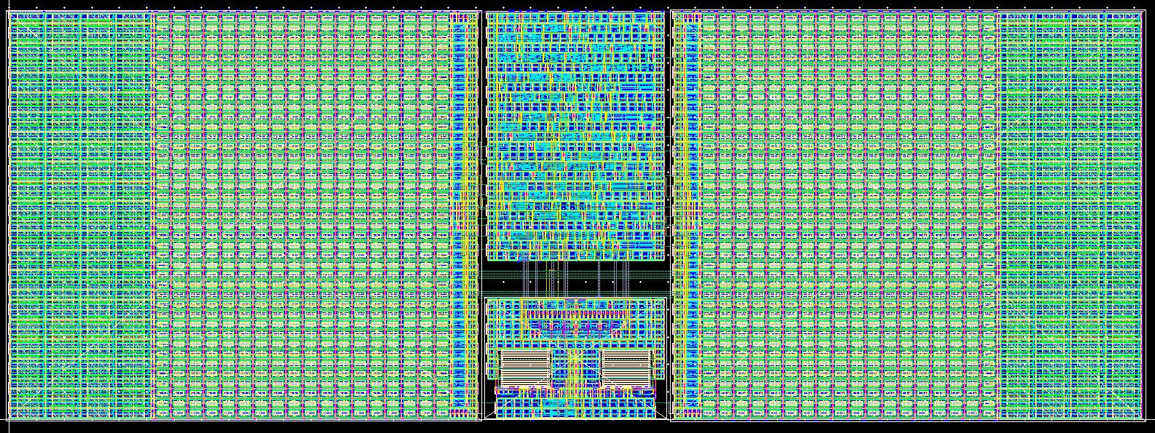
4. ADC Core Layout
Fig. 19. Layout of ADC core
19

Slide 22
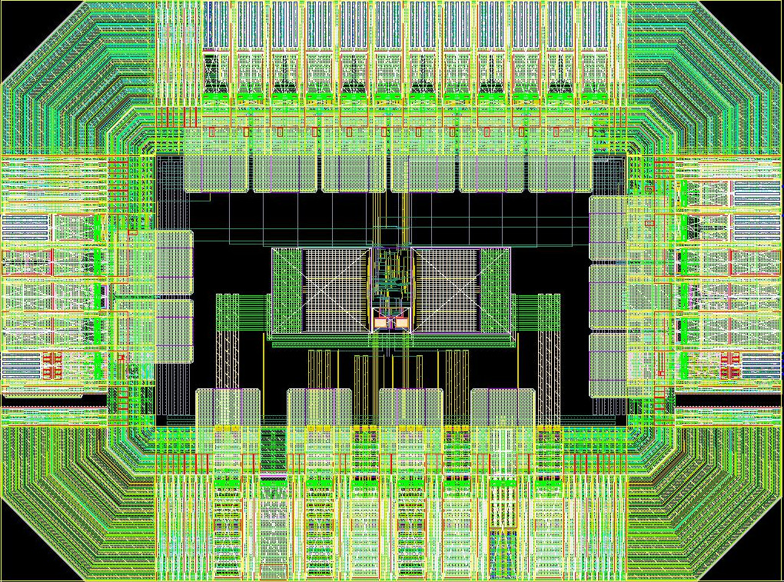
5. Full-Chip ADC Layout
Full-chip ADC simulation: using ADC core (post- layout) and pads (pre-layout), verifying the function.
generate netlist of the full-chip ADC.
Call the ADC netlist and library files in script.
Create floorplan in ICC.
Placement and routing.
Checking LVS and DRC.
It should be noticed that, PRES and PRES2 cell in RAIL lib were used to solve problem of DRC. In schematic, these resistors should be replaced by rppoly in tsmcN65 lib.
Fig. 20. Schematic of the full-chip ADC
20

Slide 23
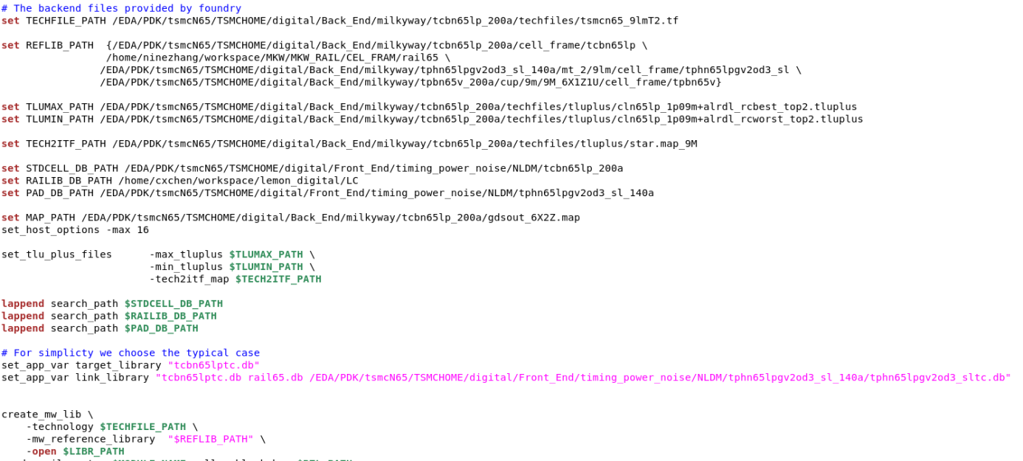
5. Full-Chip ADC Layout
Fig. 21. Setting library files and configuration files for full-chip ADC
Fig. 22. Calling full-chip ADC netlist
21

Slide 24
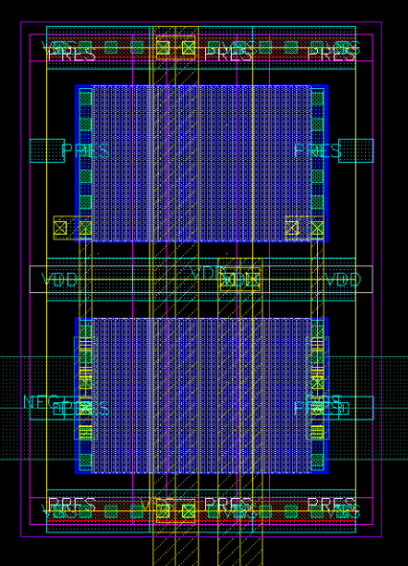
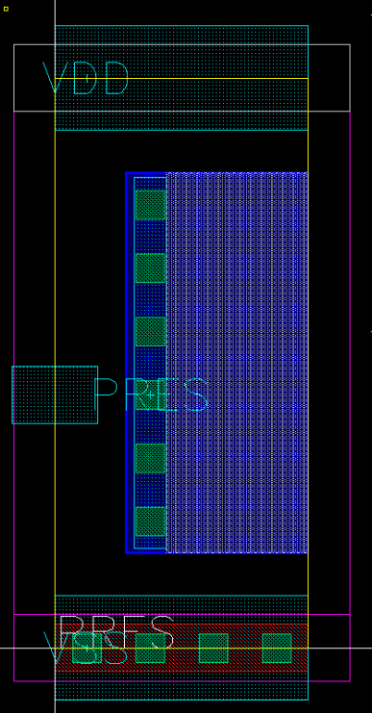
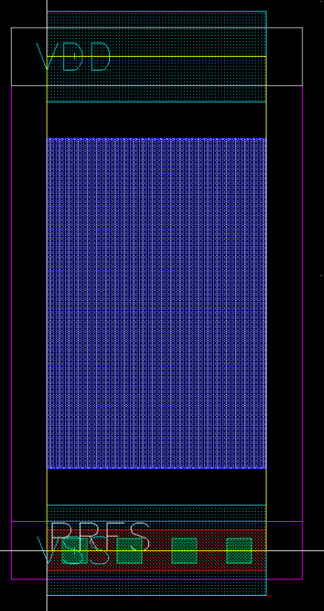
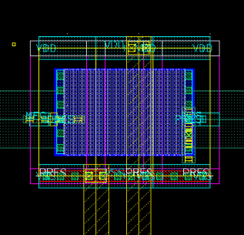
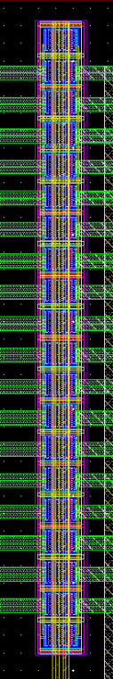
5. Full-Chip ADC Layout
(a) PRES
(b) PRES2
Fig. 23. Layout of PRES (a) and PRES2 (b)
(a)
(b)
Using PRES and PRES2, we can create any small value of resistance (the maximum resistance is about 20Ω).
We should place PRES at two sideways, and PRES2 at middle.
(c)
Fig. 24. PRES resistors in full-chip ADC layout: (a) one resistor, (b) 2 resistors shunt, (c) 20 resistors shunt.
22

